Slide 1

12:34
12:39
12:49
12:52

Slide 4



Slide 5








Slide 8


Slide 9
Helsinki 12:30
http://www.fontspace.com/category/thin?p=2
http://www.fontspace.com/nimavisual/trench

Slide 10




Slide 11





Slide 13






Slide 14
M

Slide 15


Slide 16



Slide 17


Slide 18





Slide 19


Slide 24





Slide 25


Slide 26



Slide 37



Slide 38


Slide 39


Slide 40


Slide 43


Slide 44


Slide 45







Slide 46





Slide 47


Ewket Apps
®
Ewket Apps
®

Slide 48










Slide 49



Slide 50



Slide 51
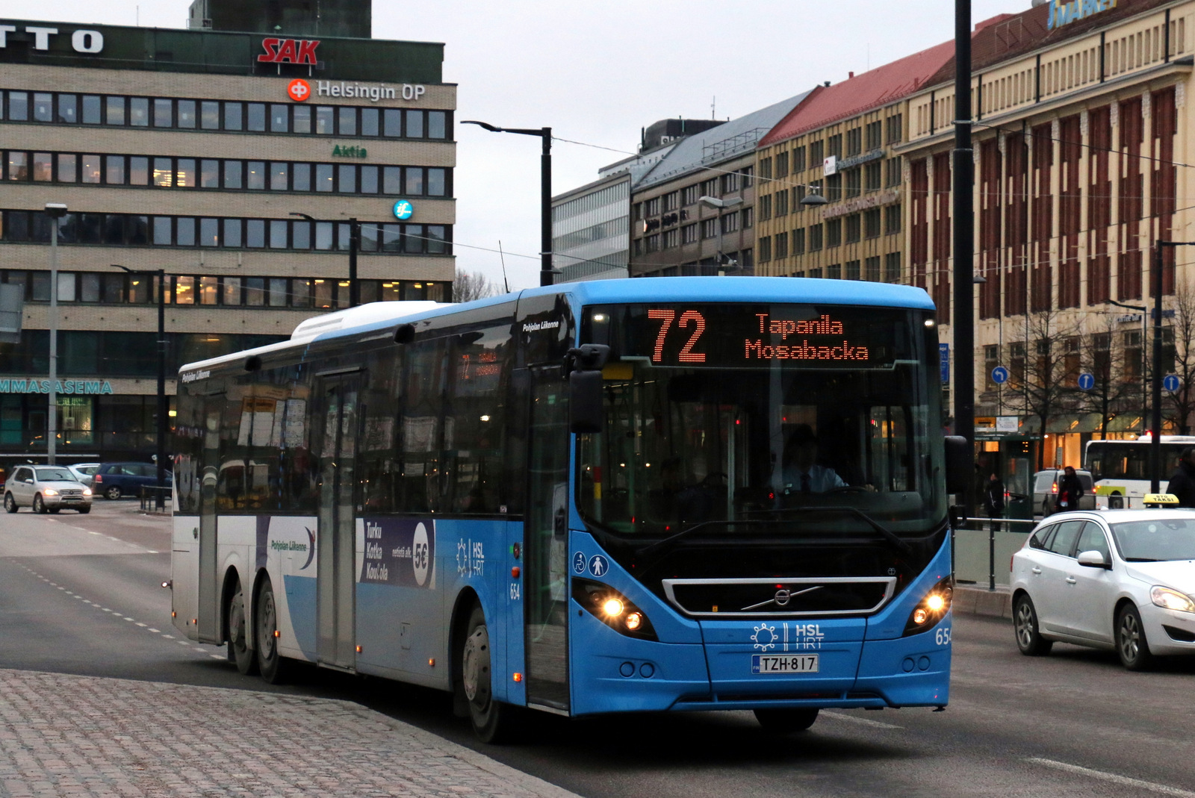

Slide 52


Slide 53
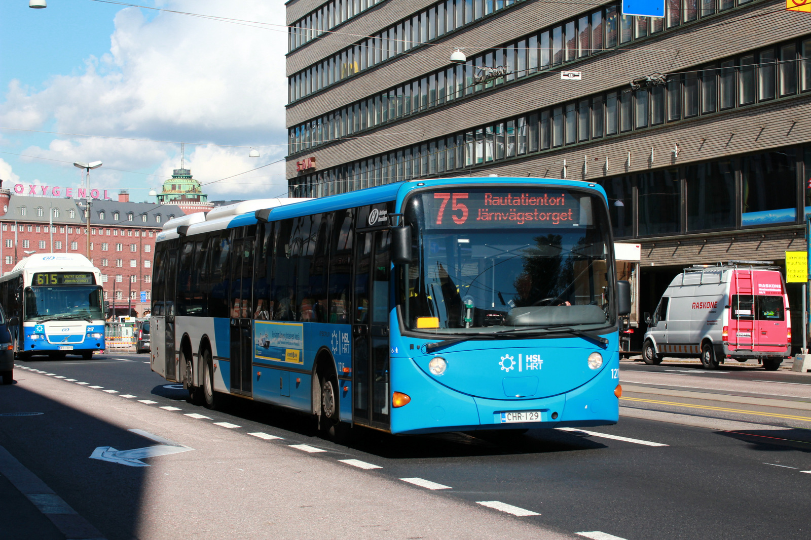

Slide 54


Slide 56
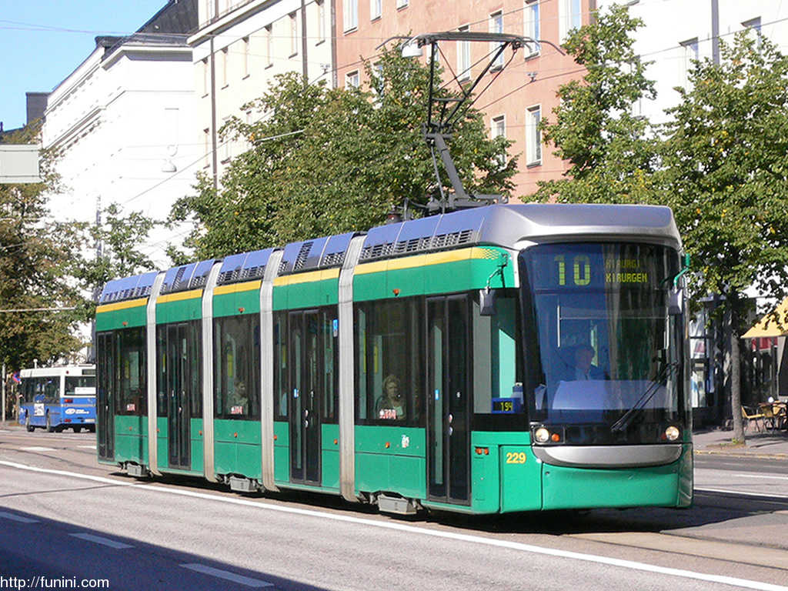

Slide 58


Slide 59
C
B
A - > C
B -> X
X = (b * C)/A
Dif = (A – B)/2
A
C * (1 – B/A)/2

